Slide 1
10-Minute Weather Safety Series
Notes:
Welcome to SCN's 10-minute weather safety series. This program will provide safety guidance for specific weather events you may face and is available to you at your convenience.

Slide 2
Extreme Heat
Notes:
This presentation will focus on ways to stay safe during periods of extreme heat.

Slide 3
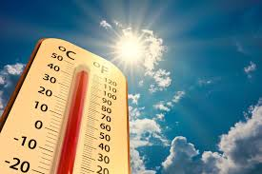
What is a . . . ?
Extreme Heat Watch
Extreme Heat Warning
Humidity
“Feels Like” temperature
Notes:
Definitions for some of the terms we will be using are as follows:
An extreme heat watch is issued when conditions are favorable for an extreme heat event, but the timing is still uncertain. It is also a good time to plan alternate activities to stay out of the heat.
An extreme heat warning is issued when dangerous heat conditions are expected or are already occurring. Avoid outdoor activities and be sure to drink plenty of water and fluids.
Humidity is the measure of water vapor in the air. When humidity is high, the air is already saturated with water vapor, making it difficult for sweat to evaporate from your skin. This reduces your body’s natural cooling mechanism, leading to a sensation of being hotter than the actual air temperature.
The “feels like” temperature or “real feel” or “humidex” is a measurement of how temperature is perceived by the human body, factoring in the actual temperature and the relative humidity. We will discuss this further in the presentation.

Slide 4
Heat Exhaustion vs. Heat Stroke
Notes:
Heat exhaustion is a condition that happens when your body overheats. Some of the symptoms of this include:
heavy sweating
faintness
fatigue
rapid pulse
headache
Heatstroke is a condition caused by the body overheating. This usually happens because of exposure to high temperatures or physical activity in high temperatures for too long.
Symptoms of this include:
high body temperature
change in mental state or behavior
nausea and vomiting
flushed skin
racking heart rate.
If you believe a person is experiencing heat stroke, immediately get the person out of the heat if you can, and call emergency services.

Slide 5
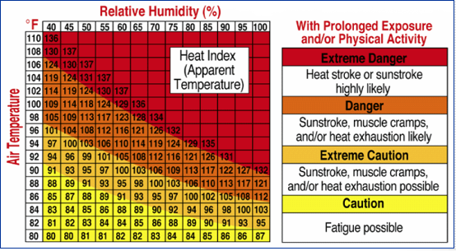
Heat Index
The Heat Index combines the actual temperature with the relative humidity.
It gives the “real feel” temperature.
If the temperature is 92 degrees and the humidity is 70%, it will feel like it is 112 degrees.
Notes:
The Heat Index is a measure of how hot it feels when temperature and humidity are combined, essentially showing the "feels-like" temperature. It's calculated using a formula that incorporates both air temperature and relative humidity. Because the moisture in the air is so much, it is harder for the body to regulate it’s temperature. For instance, if the air temperature is 92, and the humidity is 70%, it will feel like 112 degrees.

Slide 6
Heat Waves
Periods of unusually hot weather.
Significantly hotter than normal.
Regional variations
Health impacts
Impacts on infrastructure, agriculture, and the economy
THE BIGGEST THREAT TO LIFE IN A HURRICANE IS THE STORM SURGE.
Notes:
A heat wave is an unusually hot stretch of weather lasting days or even weeks. There is no country-wide measurement of what constitutes a heat wave as regional variations are normal.
Because there is no respite from the heat, the effects on the human body are cumulative: in other words, the effects keep building without giving the body time to recover. Some groups, such as the elderly, children, and those with medical issues are more at risk than others.
During a 1995 heat wave in Chicago, over 730 people died in a one-week period when temperatures reached 106 and heat indexes reached over 120 degrees

Slide 7
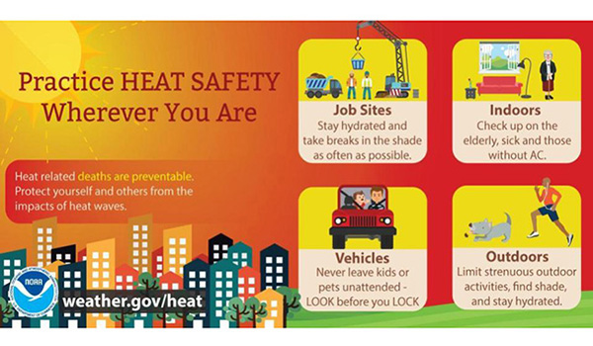
Heat Safety
Notes:
Even in regular summer temperatures, it is important to take care of yourself a be aware of your surroundings.
Outside workers, whether construction or other jobs requiring you to be exposed to heat for extended periods of time should take regular breaks and ensure you keep hydrated.
In a vehicle, always look before you lock. Look for infants, children, or pets that may inadvertently be left behind.
Leave strenuous workouts for a cooler day or move them indoors. In many cases, by the time you feel the effects of the heat, you are already in danger.
If you have elderly or infirm neighbors, check on them on the really hot days. If you know a neighbor doesn’t have air conditioning, keep an eye on them and help them as much as you can to get into a cooler environment.

Slide 8
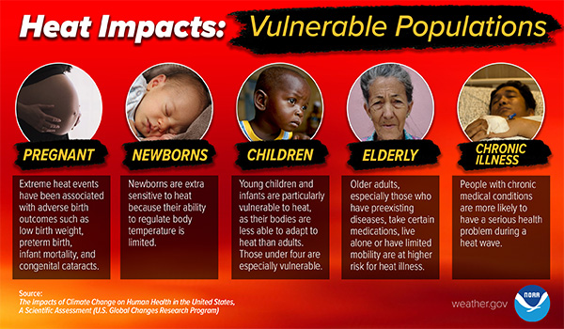
Functional Needs Populations
Not everyone is able to regulate their body temperature as easily as is needed.
Pregnant women, the very young, and the elderly are more prone to heat illness than healthy adults.
Be a good neighbor and check on your neighbors on extreme heat days.
Notes:
The impacts of heat vary on differing populations.
A pregnant woman should be careful not to become too overheated at anytime during her pregnancy. Increased internal temperatures upwards of 102 degrees have been linked to birth defects and other pregnancy complications.
Newborns have a limited ability to regulate their body temperature and are more susceptible to overheating. Generally speaking, many experts recommend parents refrain from taking babies outside for long periods of time if the heat index is greater than 90 degrees.
Children have a smaller body mass to surface area than adults, making them more vulnerable to heat-related issues. Children are more likely to become dehydrated than adults because they can lose fluid more quickly.
The elderly are more prone to underlying health conditions that may worsen heat stress and change normal body responses to heat. Additionally, they are more likely to take prescription medicines that affect the body’s ability to control its temperature or sweat.

Slide 9
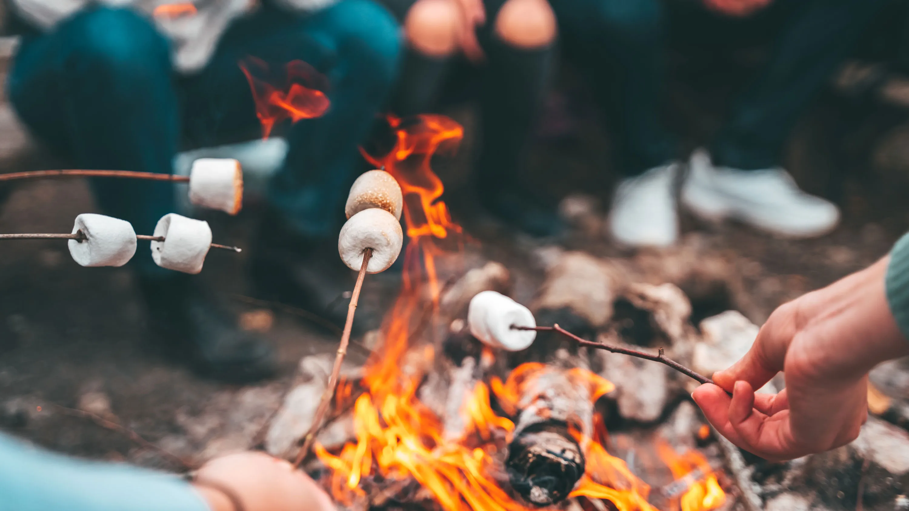
Camp Safety
Prioritize hydration, shade, and appropriate clothing.
Schedule outdoor activities during cooler times.
Be aware of the signs of heat-related illnesses and have a plan for responding to them.
Be aware of hot tents and whether anyone is in them.
Notes:
To ensure summer camp safety during hot weather, prioritize hydration, shade, and appropriate clothing.
Encourage frequent water breaks, schedule outdoor activities during cooler times,
Additionally, both leaders and campers should be aware of the signs of heat-related illnesses and leaders should have a plan for responding to them.
During hot weather, tents act like a greenhouse and become a storage area for heat, making getting back in the tent feel like you’re getting into a sauna. Camp leaders should be aware of whether any campers have been inside a tent for long periods. If possible, tents should be disassembled during the day. This will prevent any accidental overheating situations and may even lengthen the lifespan of the tent.

Slide 10
Cars: Where’s Baby?
Every death of a child in a hot car is preventable.
Even on a mild day, a car can heat to dangerous levels in a short period of time.
Park. Look. Lock.
Notes:
Every death of a child or pet in a hot car is a preventable death. Simply rolling down the window a bit does little to change the temperature inside a car and will not prevent and over heating death. Never leave a child or pet in a hot car alone for any amount of time.
Always remember: Park. Look. Lock

Slide 11
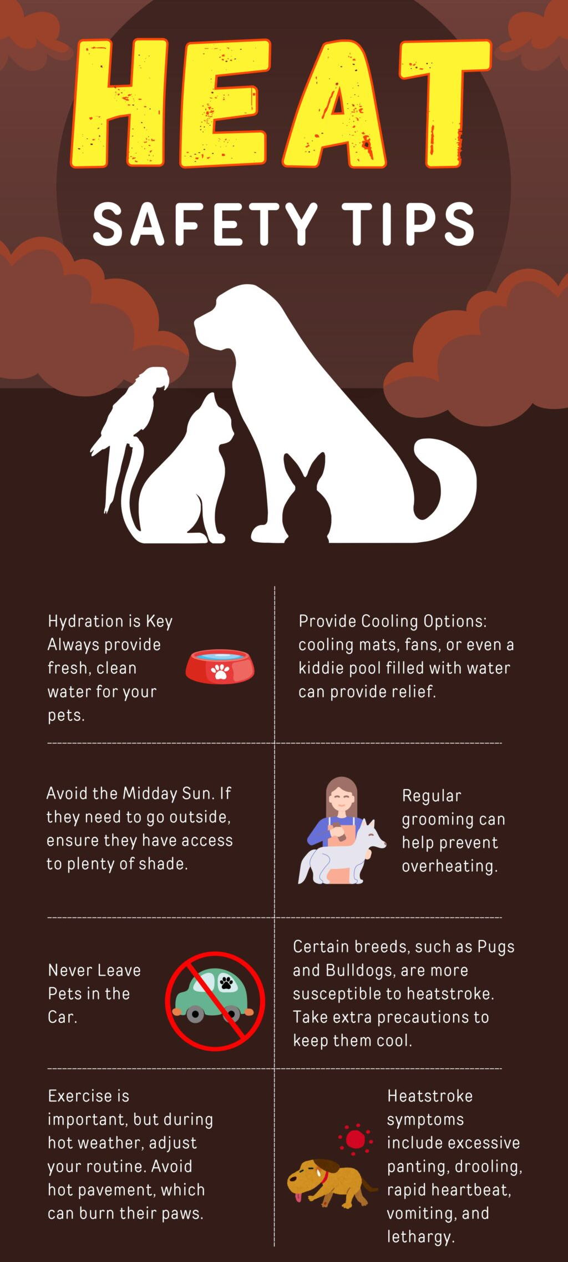
Pet Safety
Provide fresh water, shade, and shelter.
Avoid overexertion.
Keep them inside if you can, only taking them out for brief periods.
NEVER LEAVE THEM IN A CAR.
Notes:
In general, pets should never be left outside in the extreme heat. They should always have access to fresh water and shade. Some dogs will want to play and play and play outside in the heat, but sometimes we have to be the mean parents and bring them inside before they want to come in.
If you are able to keep your dogs inside during the extreme heat, it is advisable to do so, taking them out only for short periods of time.
It is very important that you remain aware of the heat and their paw pads. Cement and asphalt can easily burn their paw pads if you are not careful. Test how hot the ground is by putting the back of your hand on the cement or roadway. If it’s too hot for you, it’s too hot for them.
And, as we stress for children, do not leave your pets in a car on a hot day. PARK! LOOK! LOCK!

Slide 12
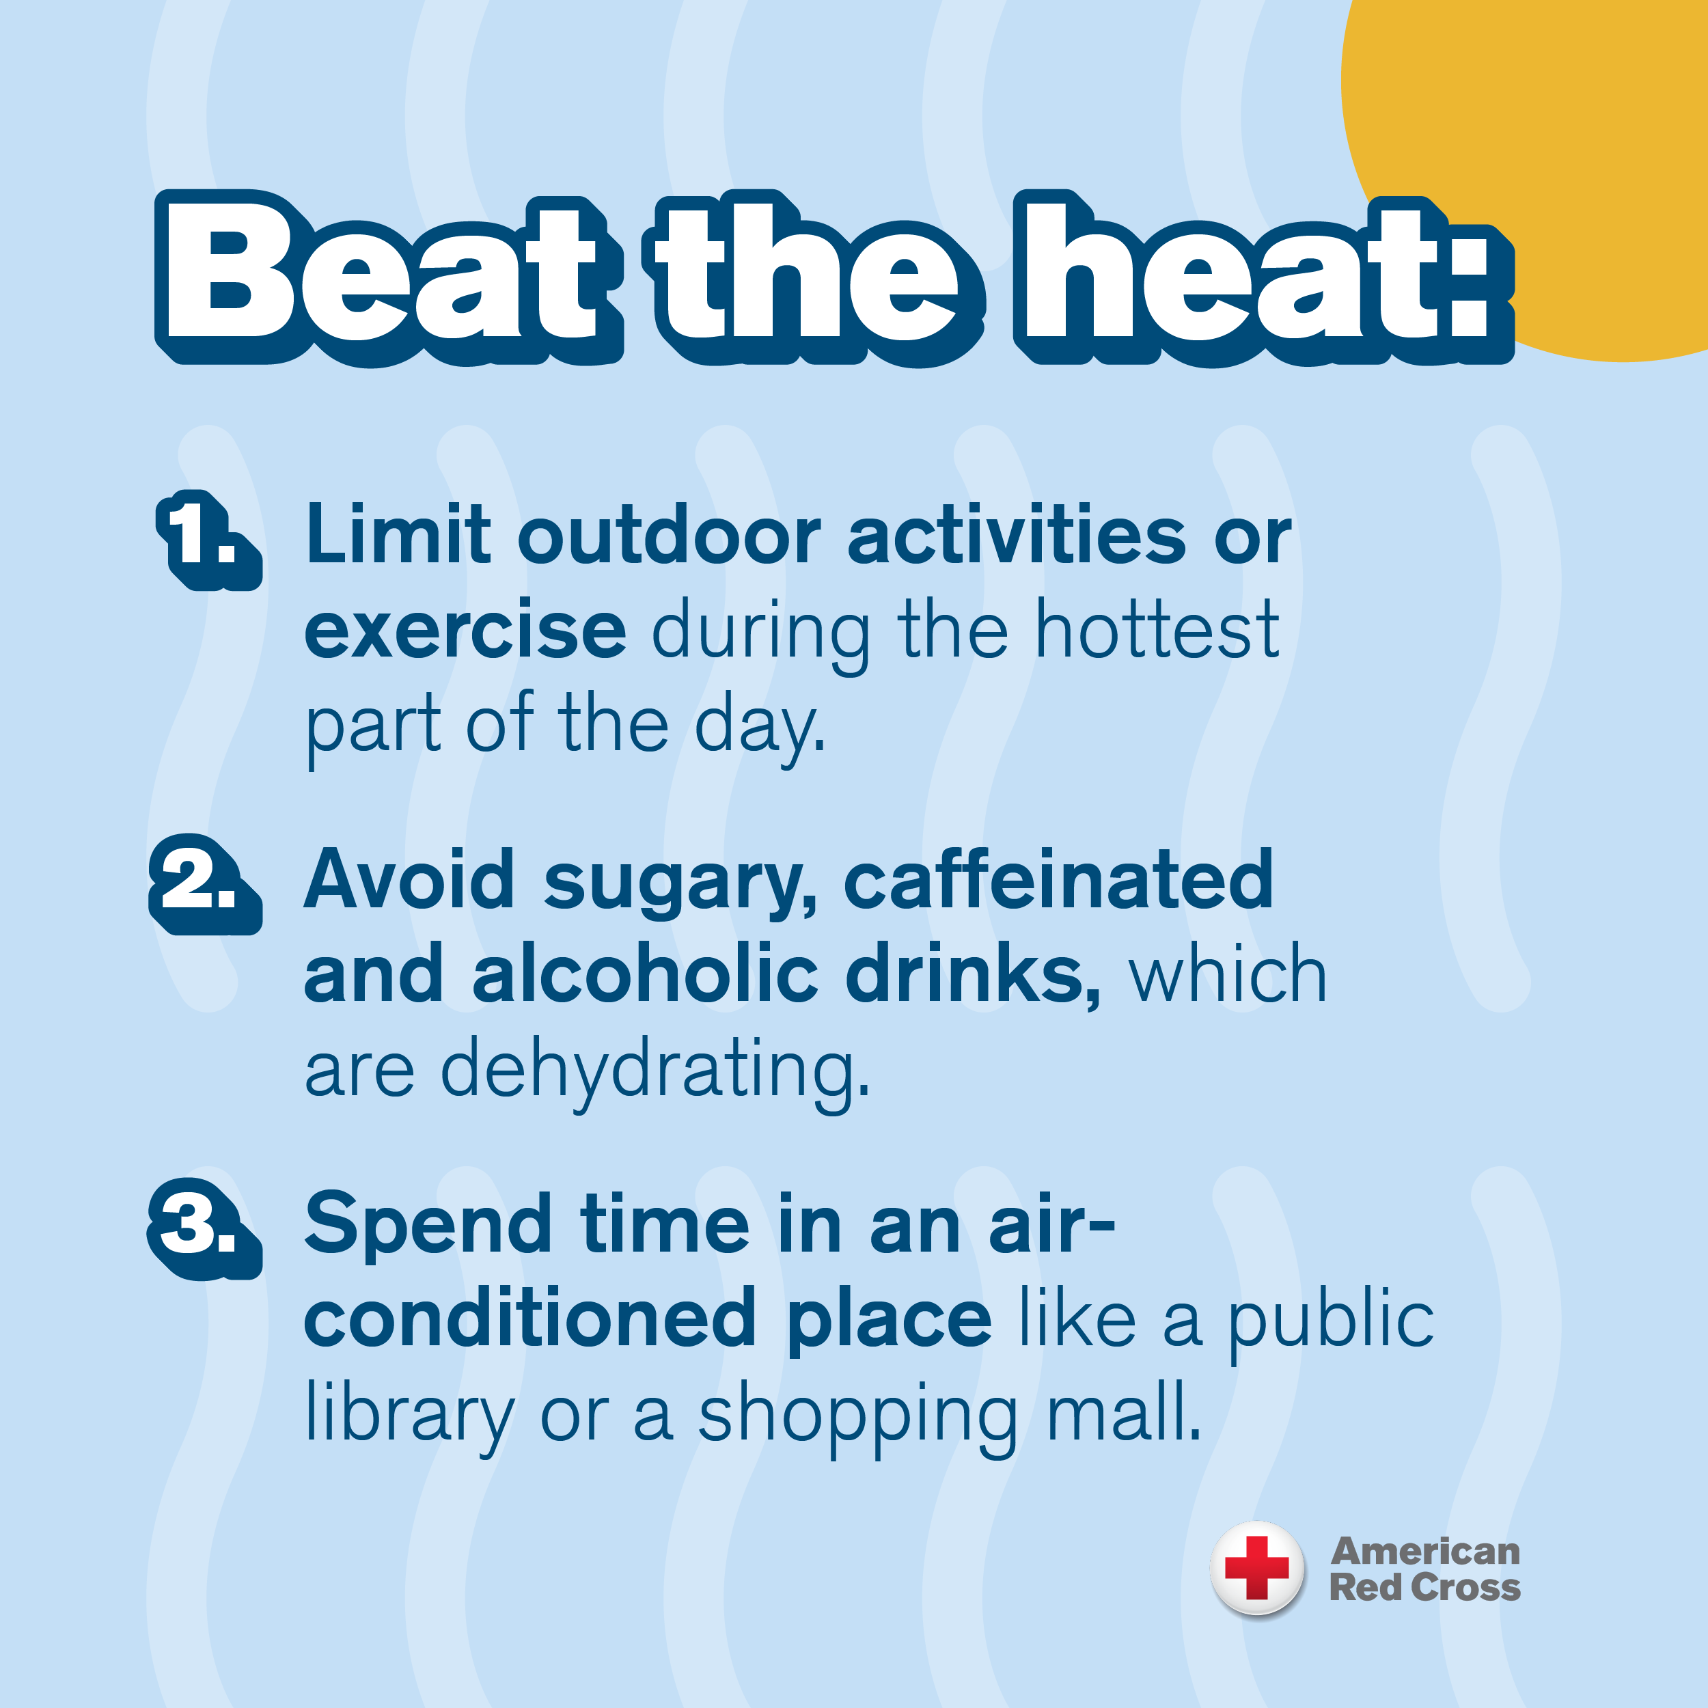
Exercise Safety
Aim for morning or evening workouts.
Stay hydrated by drinking water before, during, and after.
Protect yourself with a hat, sunscreen, and loose-fitting clothing.
Notes:
When exercising outdoors, try to avoid doing so in the extreme heat or the middle of the day. Staying hydrated is of utmost importance. Drink water before, during and after you workout to avoid becoming dehydrated.
Protect yourself with a hat, sunscreen, and loose-fitting, light-colored clothing and don’t go full speed if you don’t have to.

Slide 13
References
SCN Duty Desk - 844–726–3375
National Weather Service – Heat Safety
American Red Cross – Extreme Heat Safety
American Veterinary Medical Association – Warm Weather Pet Safety
Centers For Disease Control: Infants and Children and Heat
Your local, county, and state Emergency Management Agencies
Notes:
In all cases, you should endeavor to get your information from official sources. These resources are just some of the many available to you. Thank you for your time and for viewing this presentation.

